Slide 1


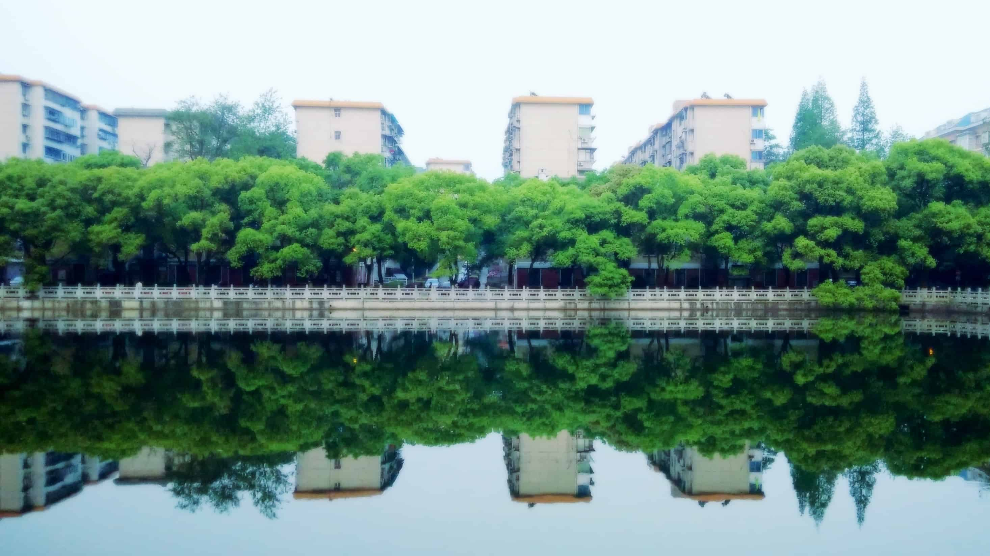

绿槐高柳，熏风入弦
中南大学绿色主题PPT
汇报人：中南云麓谷

Slide 2

目录
此处添加标题
此处添加标题
01.
02.
In the future, we need to work together to be creative, to be brave, to persist, to be persistent, to work hard, so as to create a beautiful future and happiness.
In the future, we need to work together to be creative, to be brave, to persist, to be persistent, to work hard, so as to create a beautiful future and happiness.
此处添加标题
此处添加标题
03.
04.
In the future, we need to work together to be creative, to be brave, to persist, to be persistent, to work hard, so as to create a beautiful future and happiness.
In the future, we need to work together to be creative, to be brave, to persist, to be persistent, to work hard, so as to create a beautiful future and happiness.

Slide 3
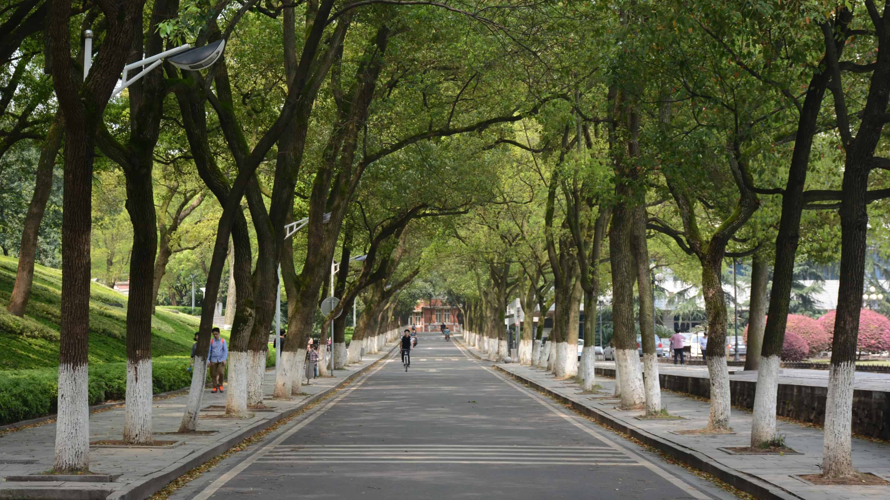
01
此处添加标题
In the future, we need to work together to be creative, to be brave, to persist, to be persistent, to work hard, so as to create a beautiful future and happiness.

Slide 4
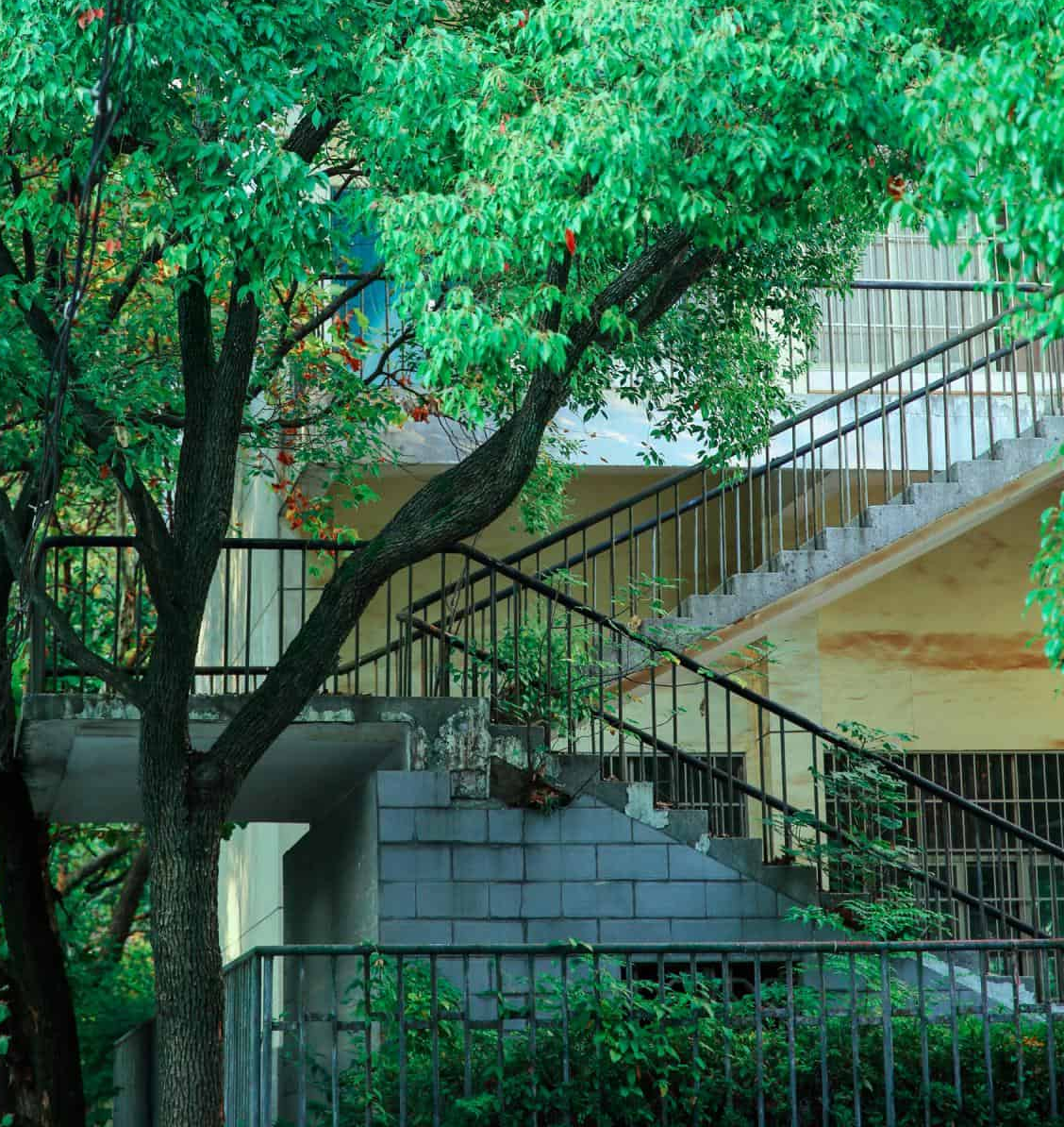
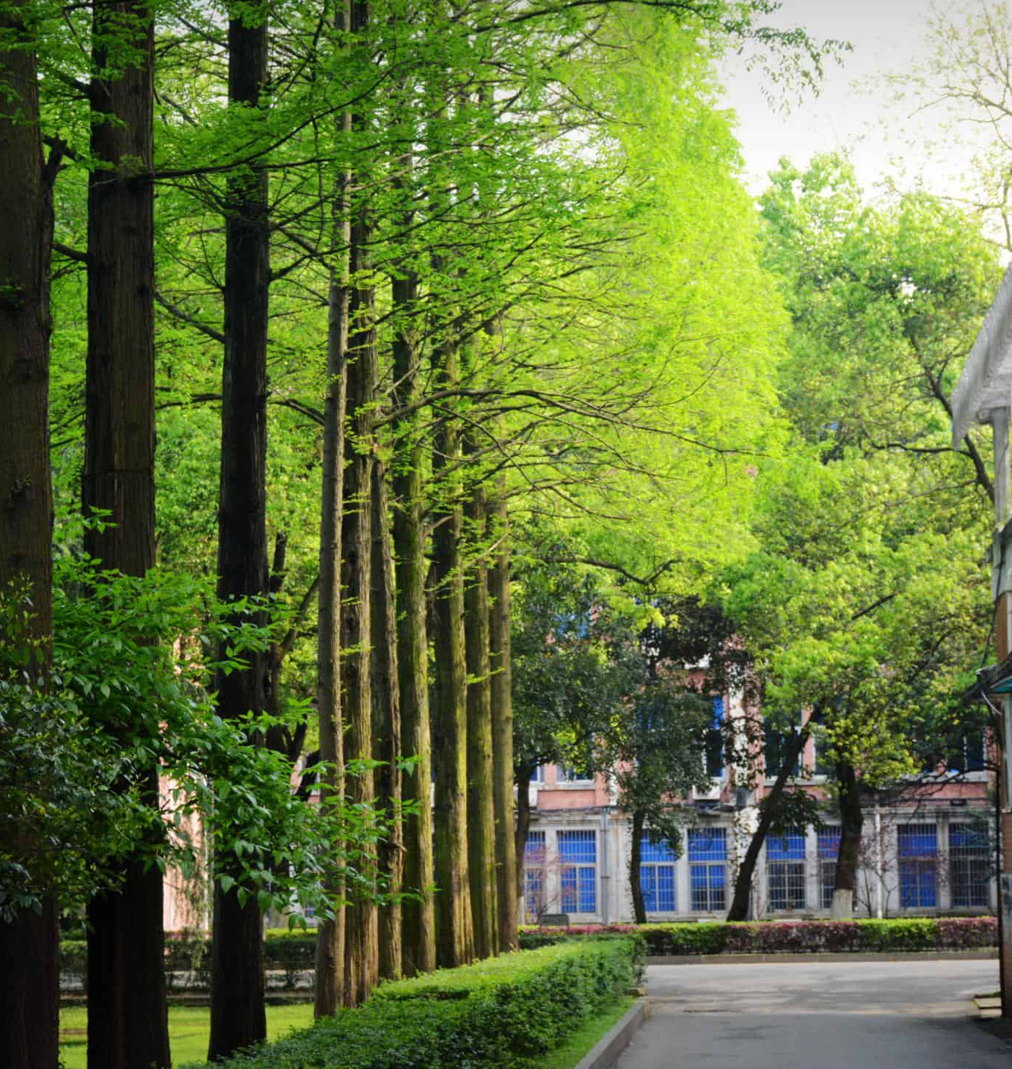
此处添加标题
In the future, we need to work together to be creative, to be brave, to persist, to be persistent, to work hard, so as to create a beautiful future and happiness.
此处添加标题
46%.
In the future, we need to work together to be creative, to be brave, to persist, to be persistent, to work hard, so as to create a beautiful future and happiness.
此处添加标题
76%.
In the future, we need to work together to be creative, to be brave, to persist, to be persistent, to work hard, so as to create a beautiful future and happiness.
此处添加标题
89%
In the future, we need to work together to be creative, to be brave, to persist, to be persistent, to work hard, so as to create a beautiful future and happiness.

Slide 5
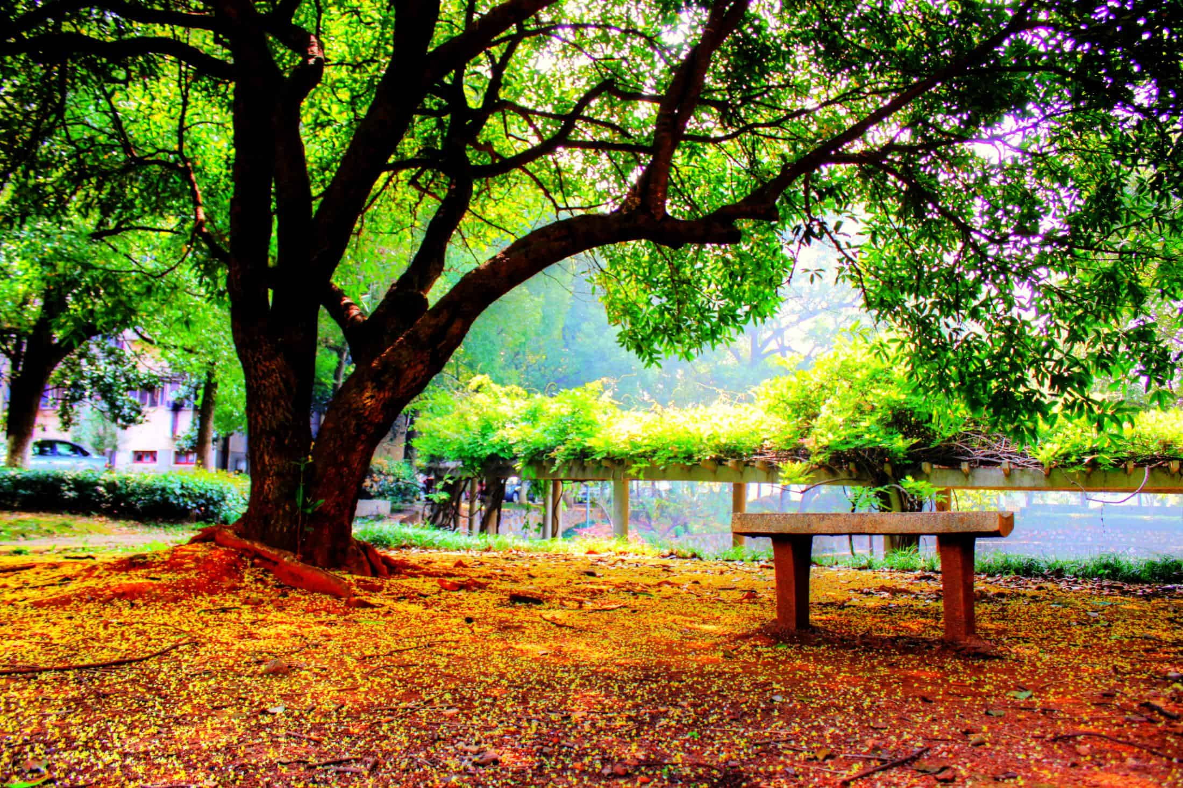

此处添加标题
In the future, we need to work together to be creative, to be brave, to persist, to be persistent, to work hard, so as to create a beautiful future and happiness.
关键字
关键字
关键字
In the future, we need to work together to be creative, to be brave, to persist, to be persistent, to work hard, so as to create a beautiful future and happiness.
In the future, we need to work together to be creative, to be brave, to persist, to be persistent, to work hard, so as to create a beautiful future and happiness.
In the future, we need to work together to be creative, to be brave, to persist, to be persistent, to work hard, so as to create a beautiful future and happiness.
关键字
关键字
关键字
In the future, we need to work together to be creative, to be brave, to persist, to be persistent, to work hard, so as to create a beautiful future and happiness.
In the future, we need to work together to be creative, to be brave, to persist, to be persistent, to work hard, so as to create a beautiful future and happiness.
In the future, we need to work together to be creative, to be brave, to persist, to be persistent, to work hard, so as to create a beautiful future and happiness.

Slide 6
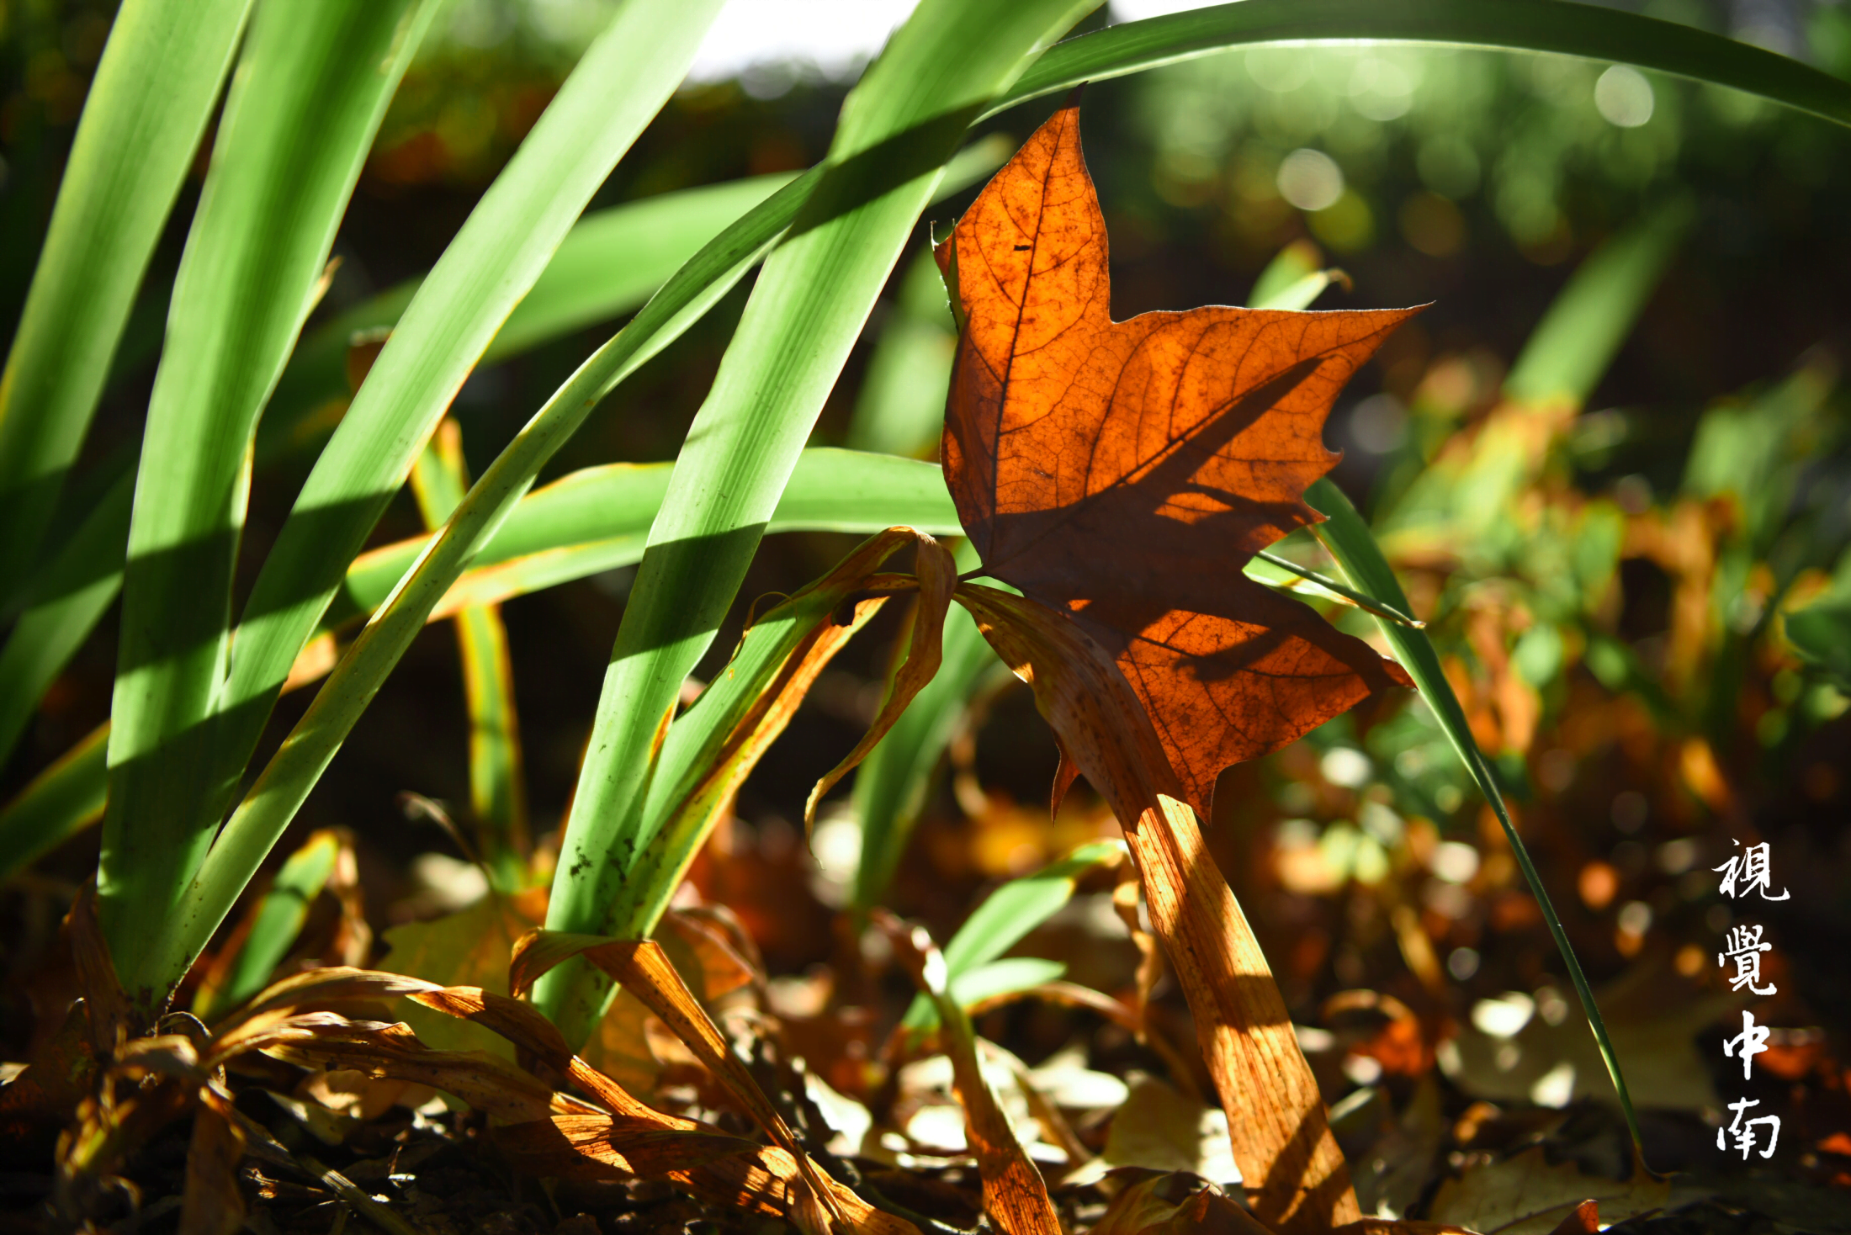
此处添加标题
In the future, we need to work together to be creative, to be brave, to persist, to be persistent, to work hard, so as to create a beautiful future and happiness.
关键字
关键字
01.
03.
In the future, we need to work together to be creative, to be brave, to persist, to be persistent, to work hard, so as to create a beautiful future and happiness.
76%
In the future, we need to work together to be creative, to be brave, to persist, to be persistent, to work hard, so as to create a beautiful future and happiness.
In the future, we need to work together to be creative, to be brave, to persist, to be persistent, to work hard, so as to create a beautiful future and happiness.
关键字
关键字
02.
04.
In the future, we need to work together to be creative, to be brave, to persist, to be persistent, to work hard, so as to create a beautiful future and happiness.
In the future, we need to work together to be creative, to be brave, to persist, to be persistent, to work hard, so as to create a beautiful future and happiness.

Slide 7
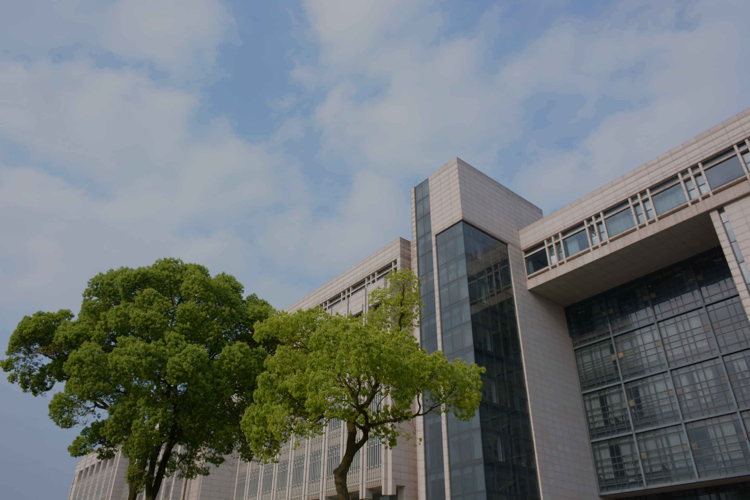
02
此处添加标题
In the future, we need to work together to be creative, to be brave, to persist, to be persistent, to work hard, so as to create a beautiful future and happiness.

Slide 8
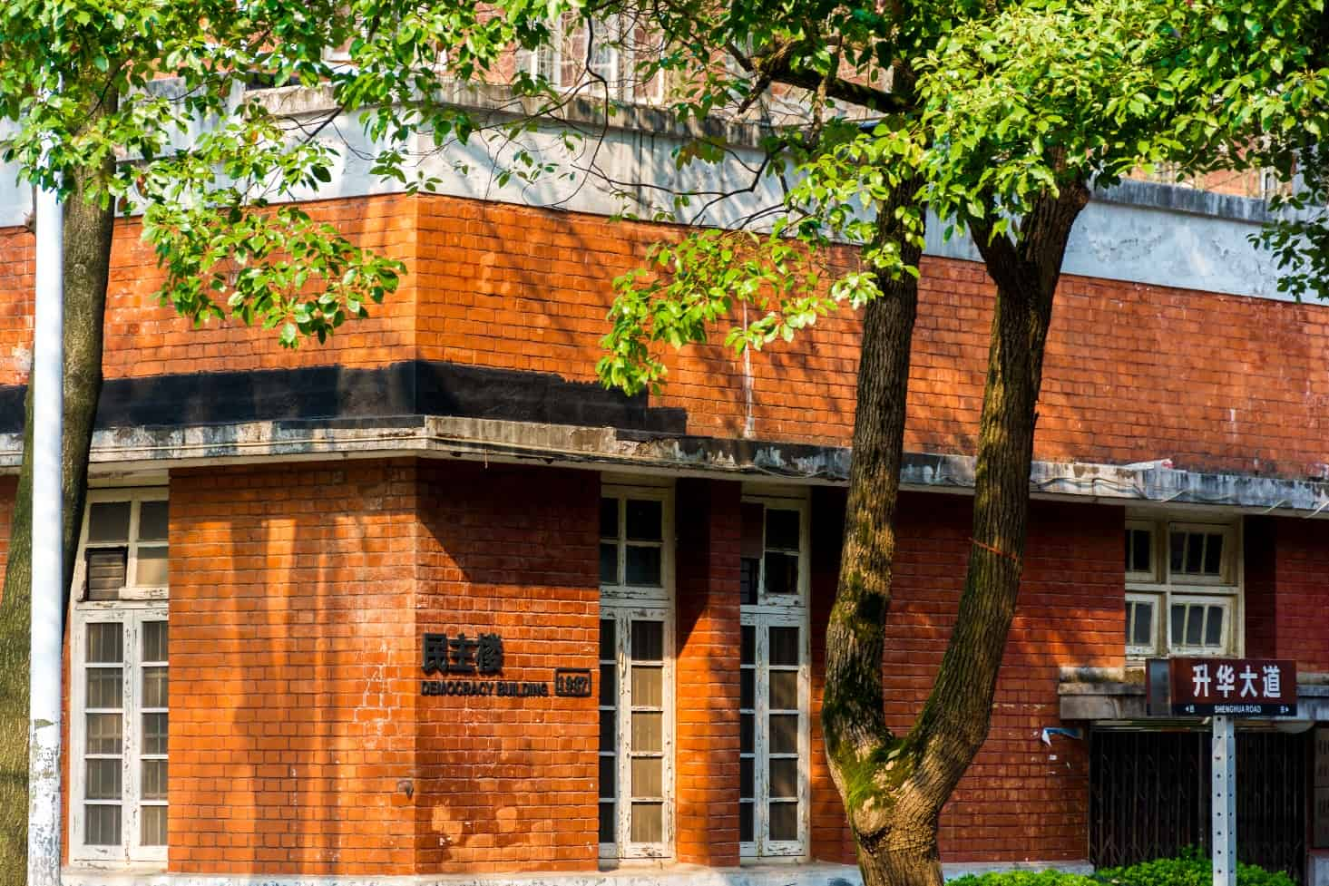
此处添加标题
In the future, we need to work together to be creative, to be brave, to persist, to be persistent, to work hard, so as to create a beautiful future and happiness.
此处添加标题
不负时光
01.
In the future, we need to work together to be creative, to be brave, to persist, to be persistent, to work hard, so as to create a beautiful future and happiness.
In the future, we need to work together to be creative, to be brave, to persist, to be persistent, to work hard, so as to create a beautiful future and happiness.
此处添加标题
02.
In the future, we need to work together to be creative, to be brave, to persist, to be persistent, to work hard, so as to create a beautiful future and happiness.
此处添加标题
03.
In the future, we need to work together to be creative, to be brave, to persist, to be persistent, to work hard, so as to create a beautiful future and happiness.

Slide 9
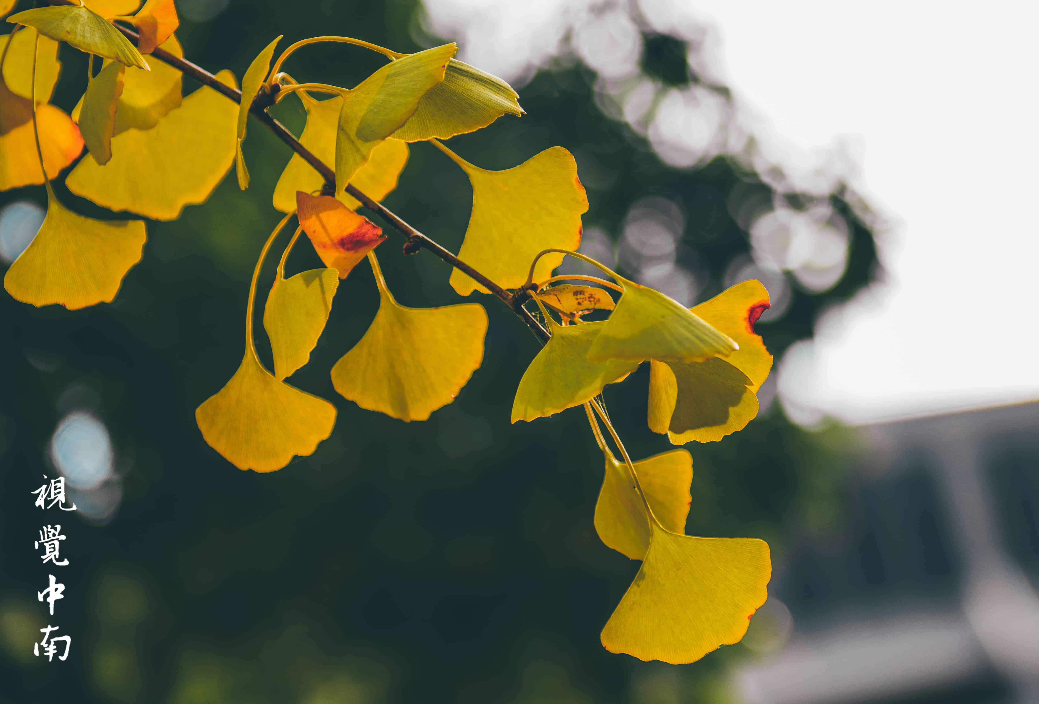
此处添加标题
In the future, we need to work together to be creative, to be brave, to persist, to be persistent, to work hard, so as to create a beautiful future and happiness.
关键字
关键字
关键字
In the future, we need to work together to be creative, to be brave, to persist, to be persistent, to work hard, so as to create a beautiful future and happiness.
In the future, we need to work together to be creative, to be brave, to persist, to be persistent, to work hard, so as to create a beautiful future and happiness.
In the future, we need to work together to be creative, to be brave, to persist, to be persistent, to work hard, so as to create a beautiful future and happiness.
关键字
关键字
关键字
In the future, we need to work together to be creative, to be brave, to persist, to be persistent, to work hard, so as to create a beautiful future and happiness.
In the future, we need to work together to be creative, to be brave, to persist, to be persistent, to work hard, so as to create a beautiful future and happiness.
In the future, we need to work together to be creative, to be brave, to persist, to be persistent, to work hard, so as to create a beautiful future and happiness.

Slide 10
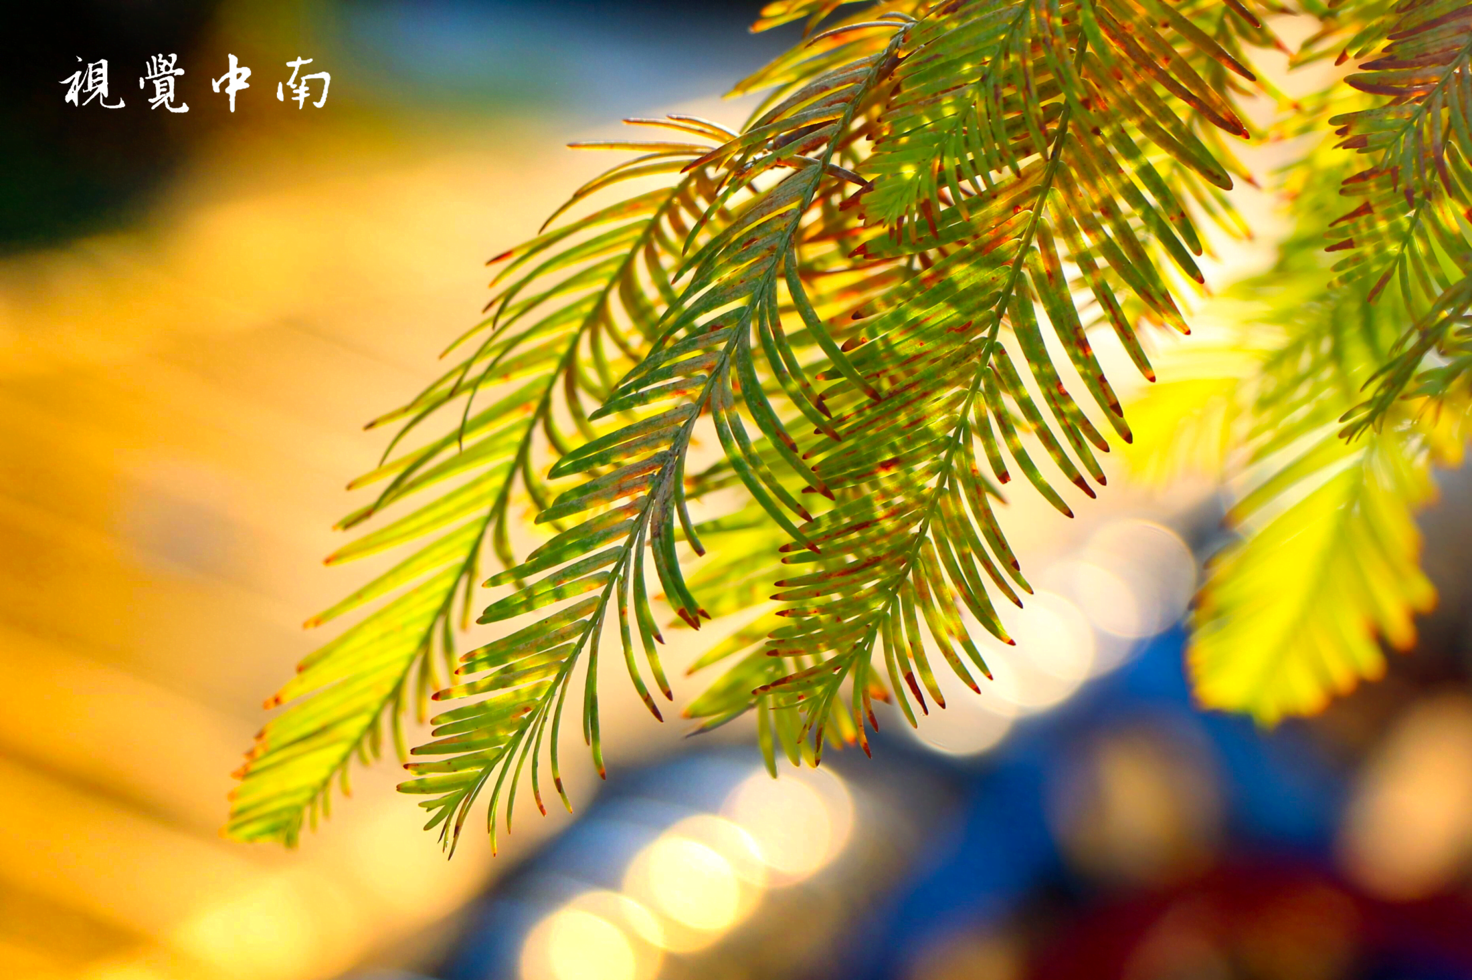
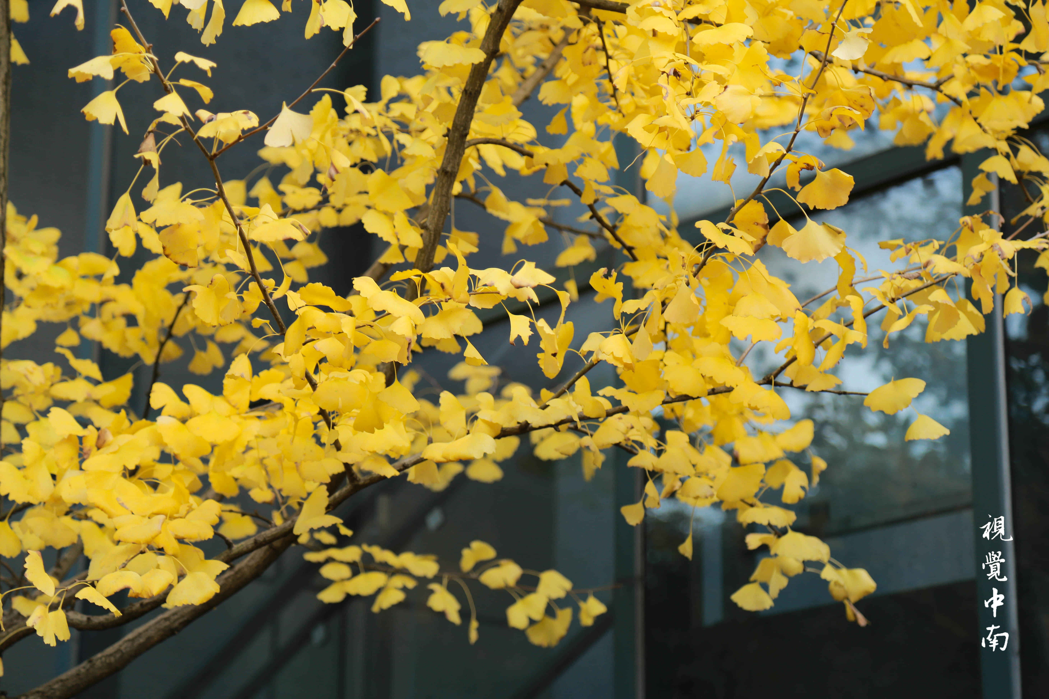
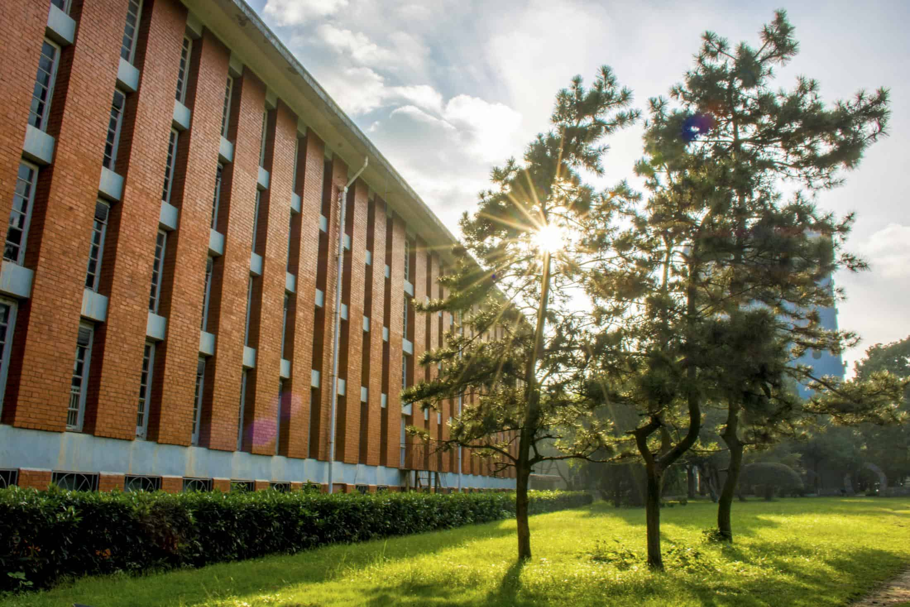
01、输入您的文字标题
添加标题
Click here to add your text.Click here to add your text，Click here to add your text.Click here to add your text，Click here to add your text.Click here
01
添加标题
Click here to add your text.Click here to add your text，Click here to add your text.Click here to add your text，Click here to add your text.Click here
02
添加标题
Click here to add your text.Click here to add your text，Click here to add your text.Click here to add your text，Click here to add your text.Click here
03

Slide 11
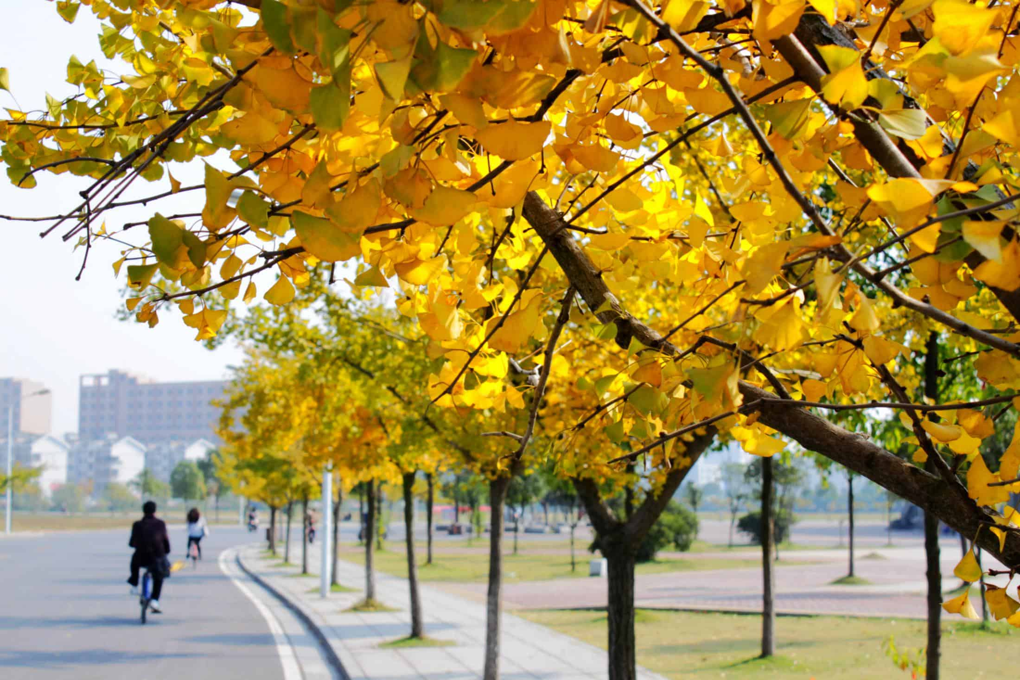
01、输入您的文字标题
10%
20%
30%
40%
此处添加标题
此处添加标题
此处添加标题
此处添加标题
In the future, we need to work together to be creative, to be brave, to persist, to be persistent, to work hard, so as to create a beautiful future and happiness.
In the future, we need to work together to be creative, to be brave, to persist, to be persistent, to work hard, so as to create a beautiful future and happiness.
In the future, we need to work together to be creative, to be brave, to persist, to be persistent, to work hard, so as to create a beautiful future and happiness.
In the future, we need to work together to be creative, to be brave, to persist, to be persistent, to work hard, so as to create a beautiful future and happiness.

Slide 12
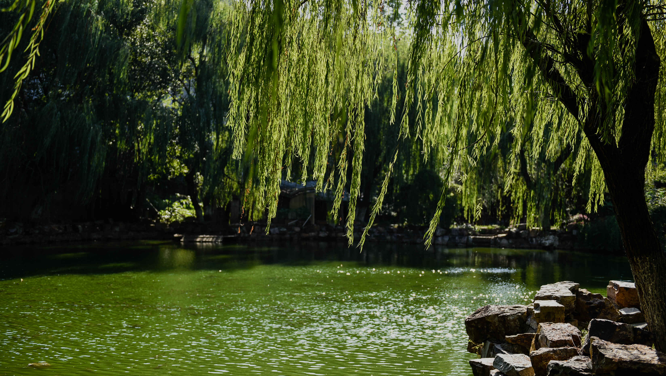
03
此处添加标题
In the future, we need to work together to be creative, to be brave, to persist, to be persistent, to work hard, so as to create a beautiful future and happiness.

Slide 13
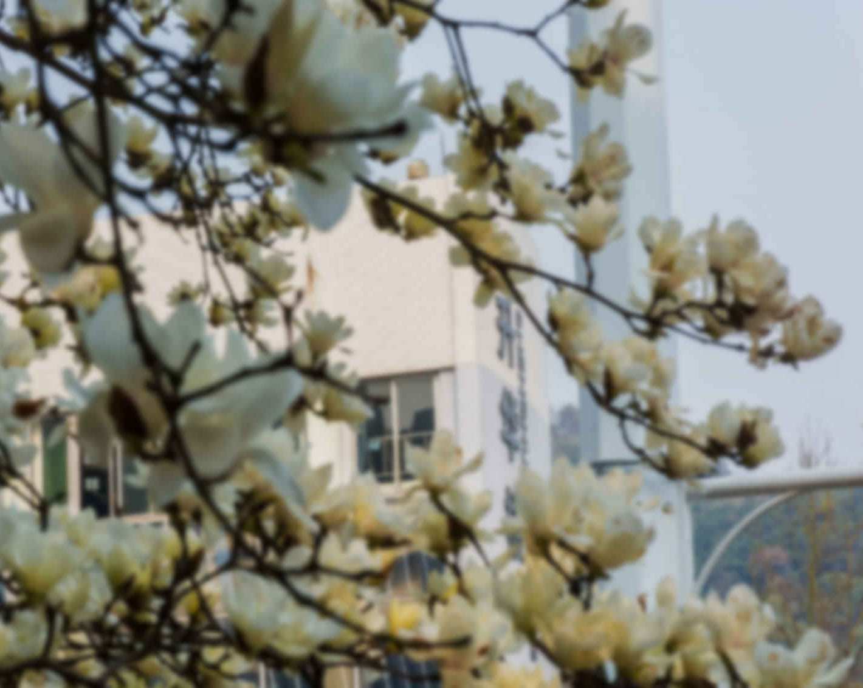
此处添加标题
In the future, we need to work together to be creative, to be brave, to persist, to be persistent, to work hard, so as to create a beautiful future and happiness.
不负时光
In the future, we need to work together to be creative, to be brave, to persist, to be persistent, to work hard, so as to create a beautiful future and happiness.
此处添加标题
01.
In the future, we need to work together to be creative, to be brave, to persist, to be persistent, to work hard, so as to create a beautiful future and happiness.
此处添加标题
02.
In the future, we need to work together to be creative, to be brave, to persist, to be persistent, to work hard, so as to create a beautiful future and happiness.
此处添加标题
03.
In the future, we need to work together to be creative, to be brave, to persist, to be persistent, to work hard, so as to create a beautiful future and happiness.

Slide 14
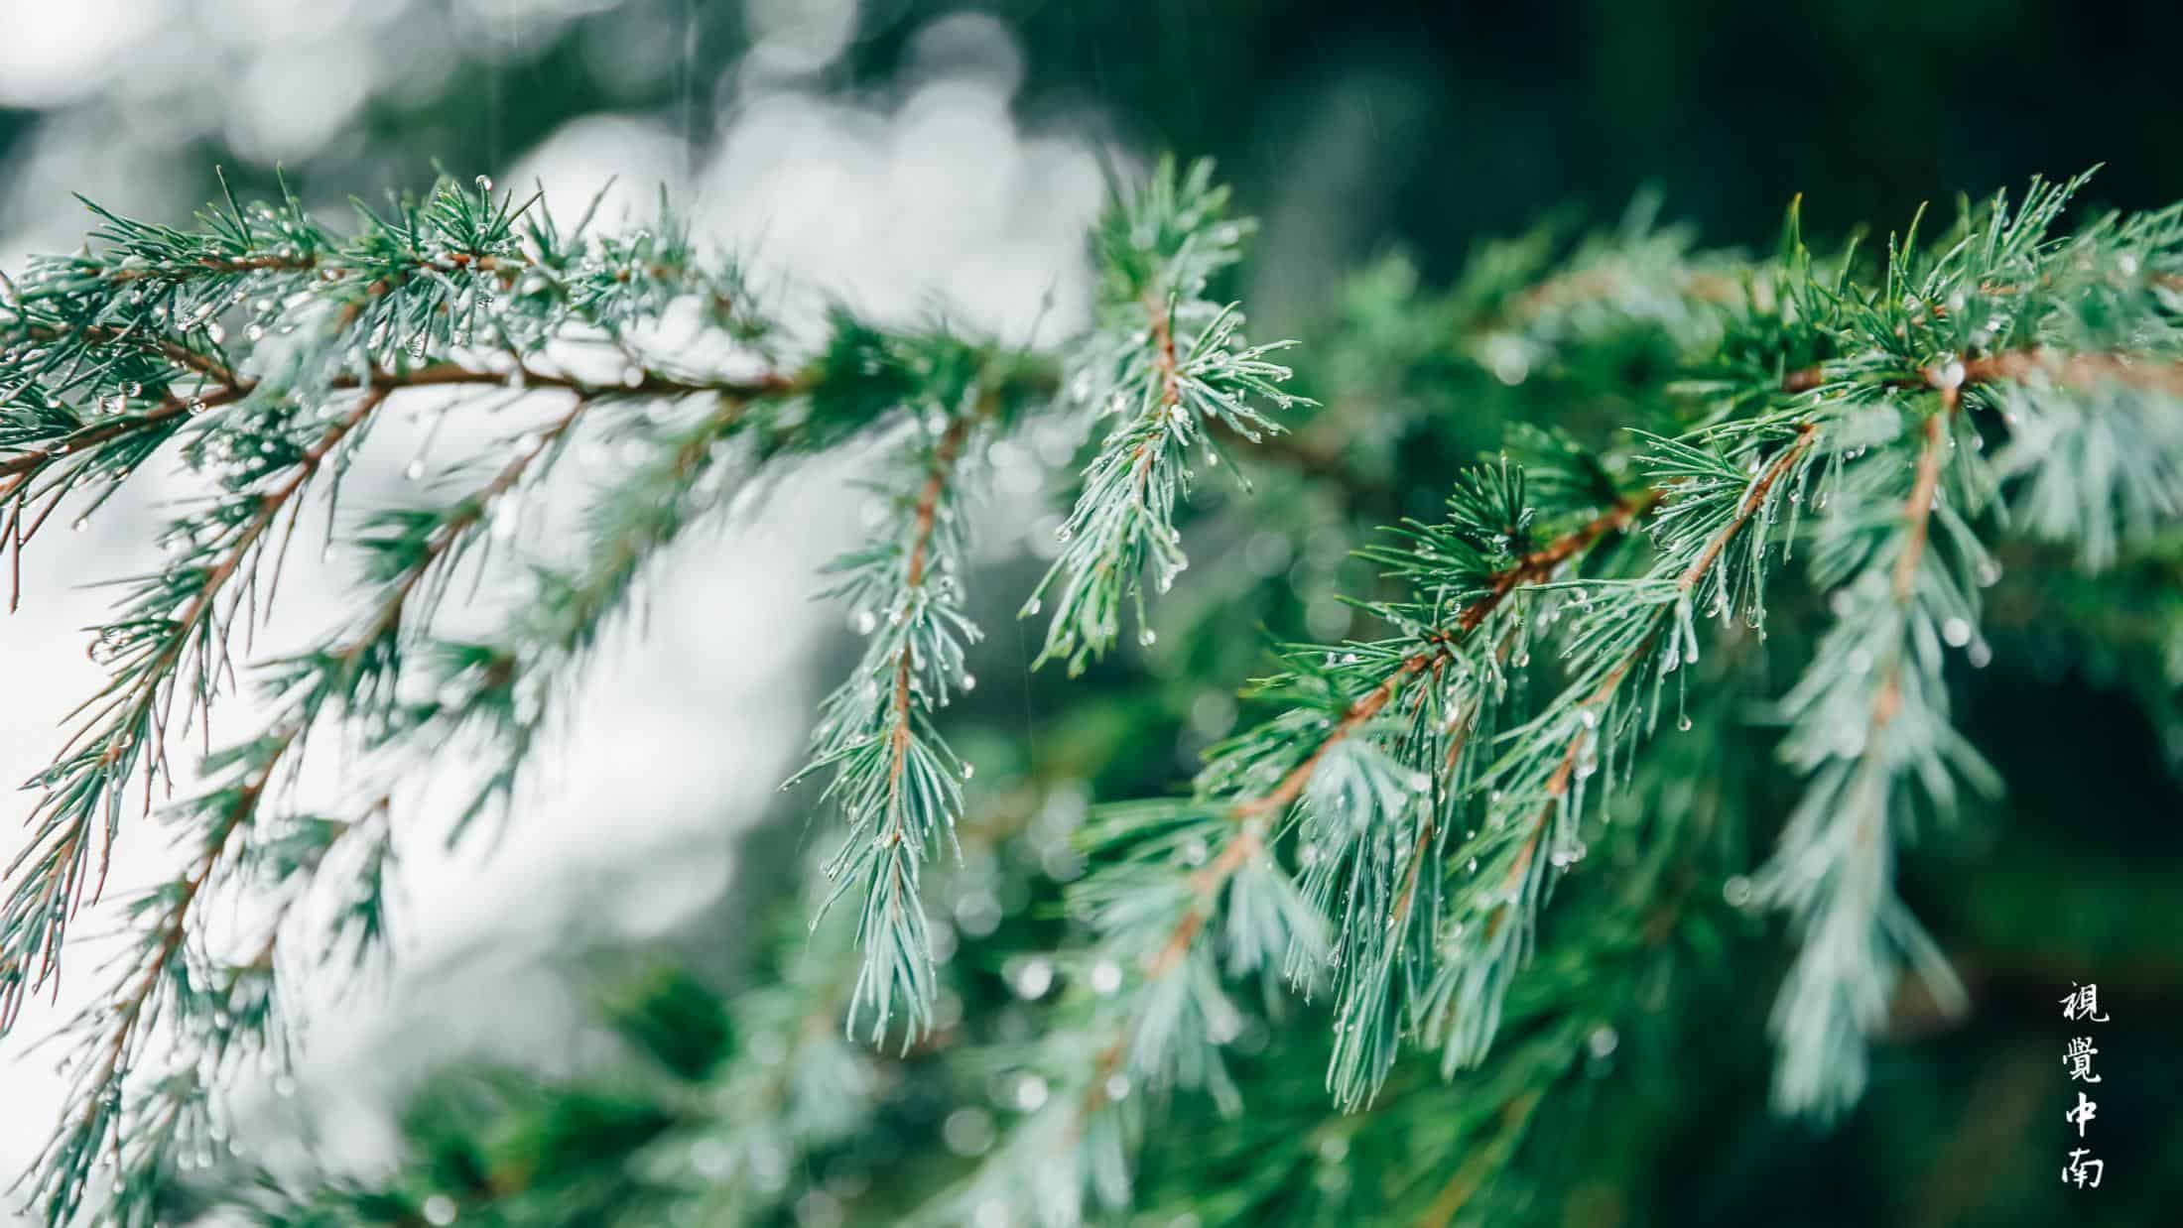
此处添加标题
In the future, we need to work together to be creative, to be brave, to persist, to be persistent, to work hard, so as to create a beautiful future and happiness.
关键字
关键字
01.
03.
In the future, we need to work together to be creative, to be brave, to persist, to be persistent, to work hard, so as to create a beautiful future and happiness.
关键字
In the future, we need to work together to be creative, to be brave, to persist, to be persistent, to work hard, so as to create a beautiful future and happiness.
In the future, we need to work together to be creative, to be brave, to persist, to be persistent, to work hard, so as to create a beautiful future and happiness.
关键字
关键字
02.
04.
In the future, we need to work together to be creative, to be brave, to persist, to be persistent, to work hard, so as to create a beautiful future and happiness.
In the future, we need to work together to be creative, to be brave, to persist, to be persistent, to work hard, so as to create a beautiful future and happiness.

Slide 15
此处添加标题
In the future, we need to work together to be creative, to be brave, to persist, to be persistent, to work hard, so as to create a beautiful future and happiness.
关键字
关键字
关键字
In the future, we need to work together to be creative, to be brave, to persist, to be persistent, to work hard, so as to create a beautiful future and happiness.
In the future, we need to work together to be creative, to be brave, to persist, to be persistent, to work hard, so as to create a beautiful future and happiness.
In the future, we need to work together to be creative, to be brave, to persist, to be persistent, to work hard, so as to create a beautiful future and happiness.
In the future, we need to work together to be creative, to be brave, to persist, to be persistent, to work hard, so as to create a beautiful future and happiness.

Slide 16
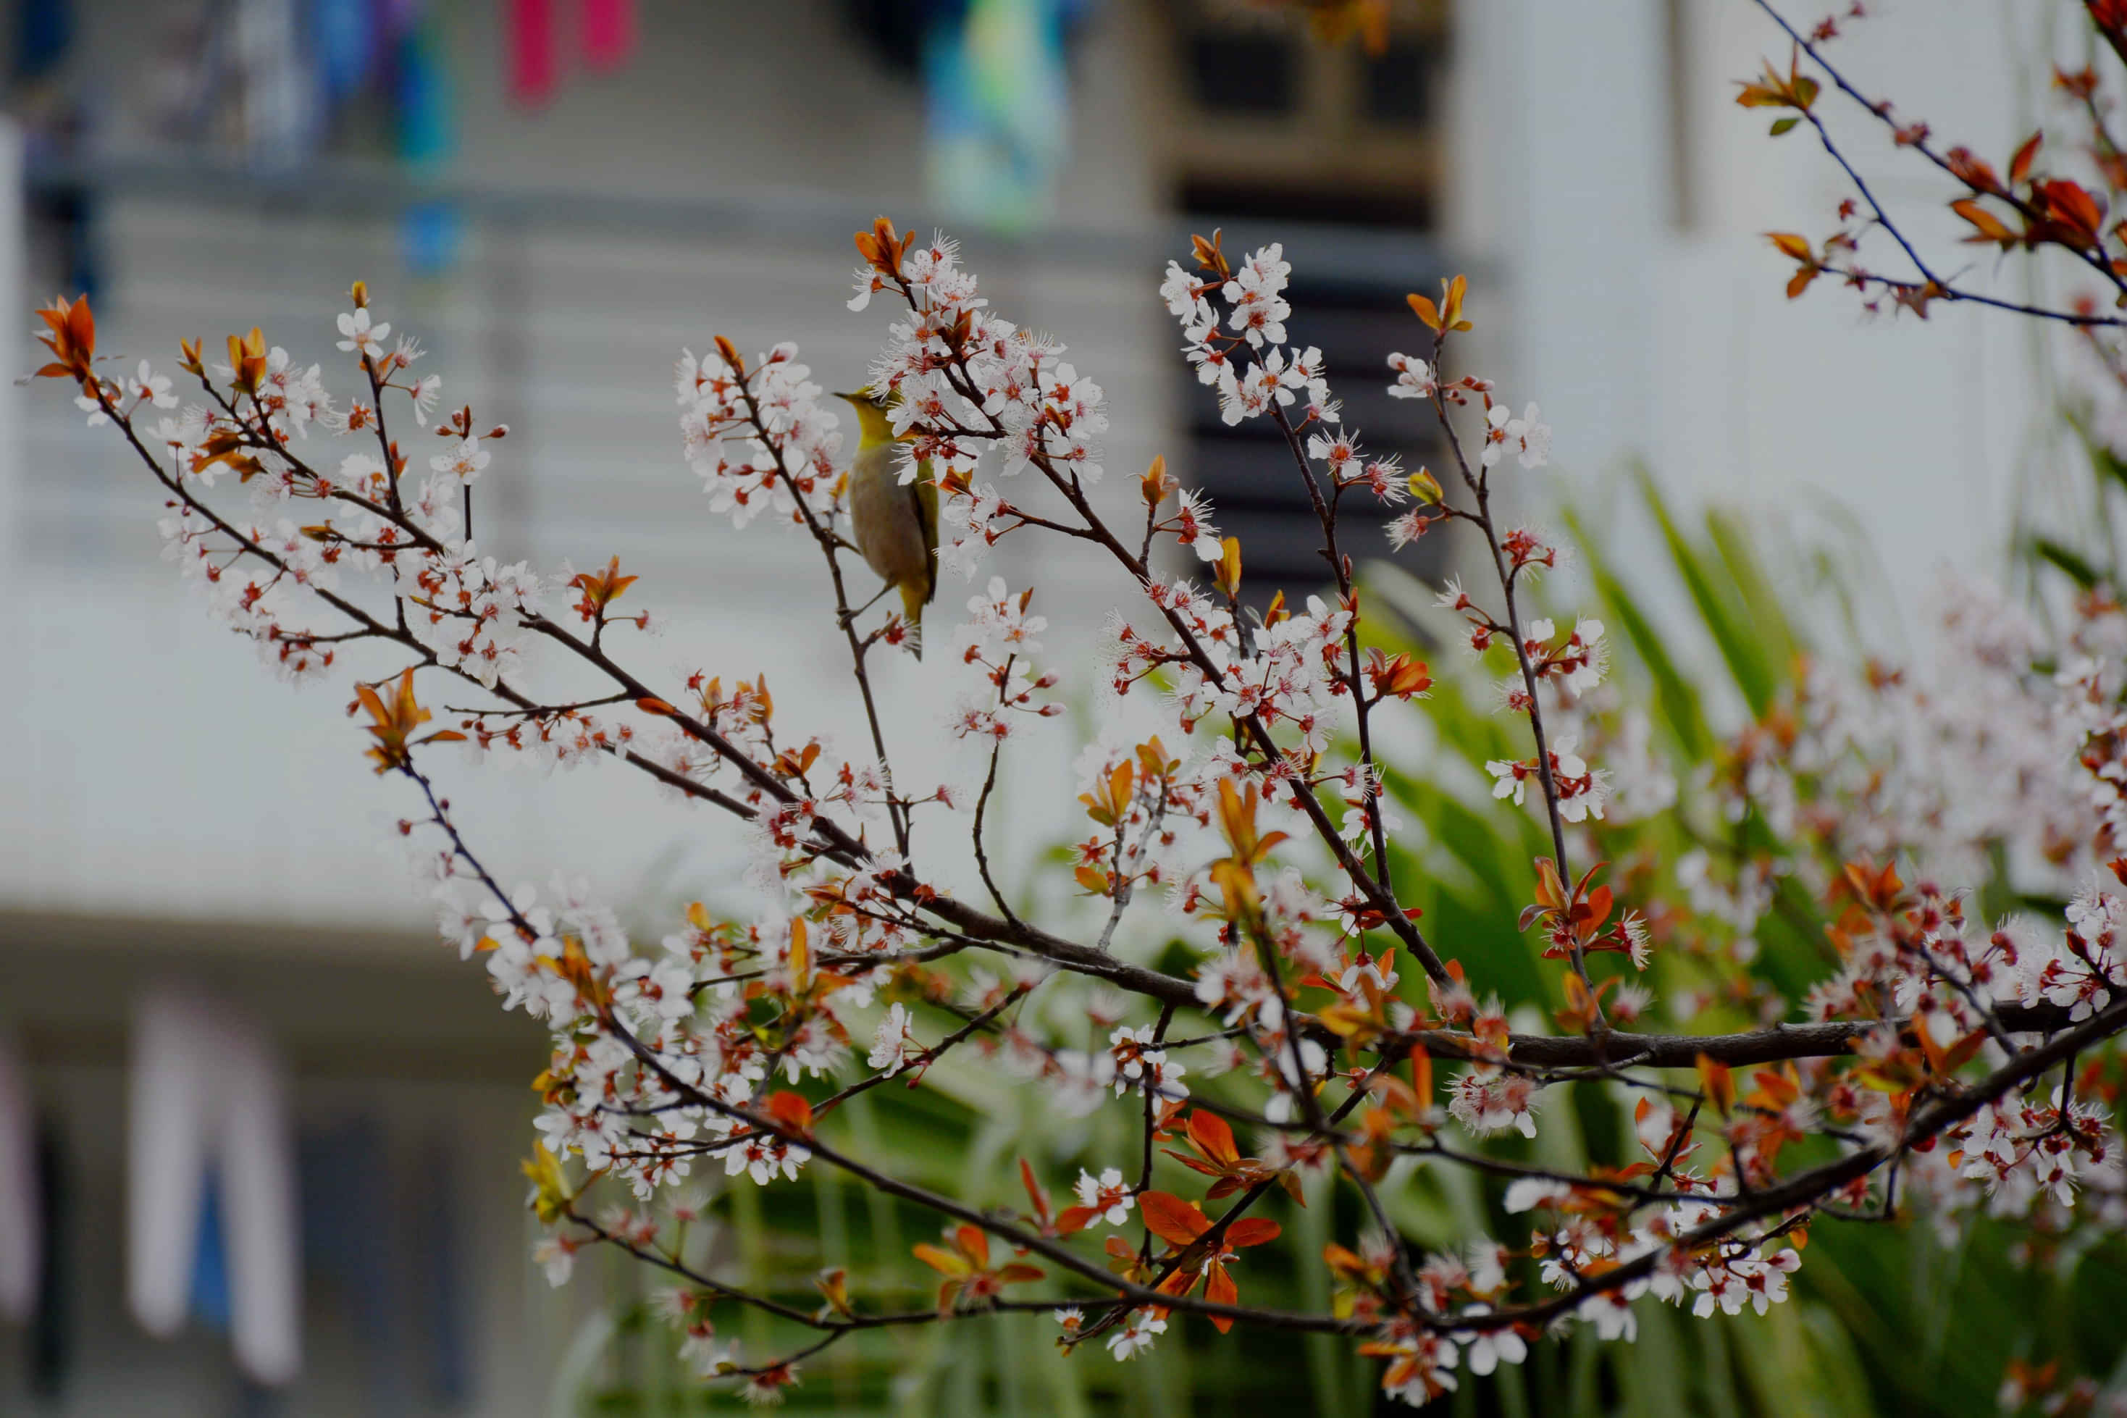
04
此处添加标题
In the future, we need to work together to be creative, to be brave, to persist, to be persistent, to work hard, so as to create a beautiful future and happiness.

Slide 17
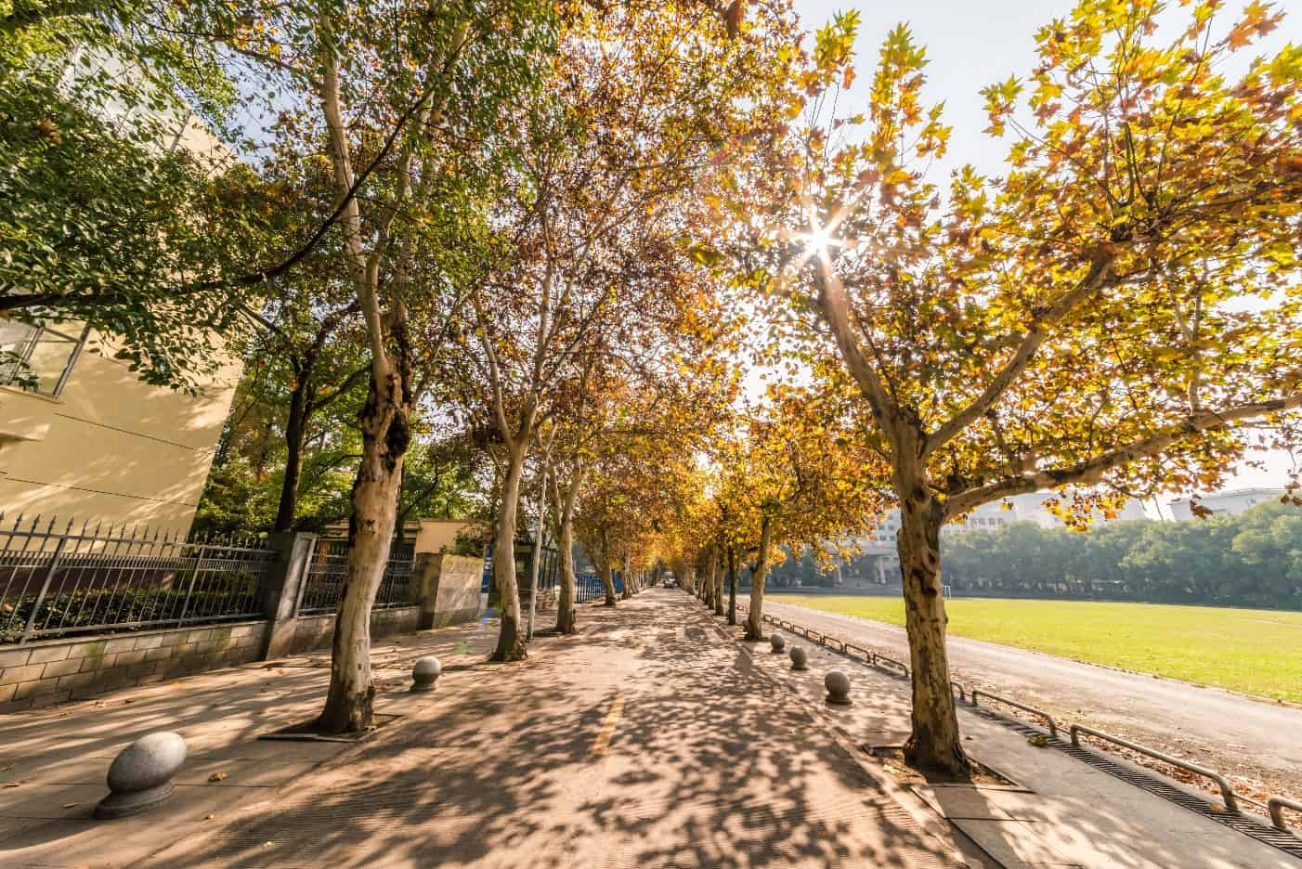
此处添加标题
In the future, we need to work together to be creative, to be brave, to persist, to be persistent, to work hard, so as to create a beautiful future and happiness.
不负时光
In the future, we need to work together to be creative, to be brave, to persist, to be persistent, to work hard, so as to create a beautiful future and happiness.
此处添加标题
1
In the future, we need to work together to be creative, to be brave, to persist, to be persistent, to work hard, so as to create a beautiful future and happiness.
此处添加标题
2
In the future, we need to work together to be creative, to be brave, to persist, to be persistent, to work hard, so as to create a beautiful future and happiness.
此处添加标题
3
In the future, we need to work together to be creative, to be brave, to persist, to be persistent, to work hard, so as to create a beautiful future and happiness.

Slide 18
此处添加标题
1
In the future, we need to work together to be creative, to be brave, to persist, to be persistent, to work hard, so as to create a beautiful future and happiness.
此处添加标题
2
In the future, we need to work together to be creative, to be brave, to persist, to be persistent, to work hard, so as to create a beautiful future and happiness.
In the future, we need to work together to be creative, to be brave, to persist, to be persistent, to work hard, so as to create a beautiful future and happiness.
此处添加标题
3
In the future, we need to work together to be creative, to be brave, to persist, to be persistent, to work hard, so as to create a beautiful future and happiness.

Slide 19
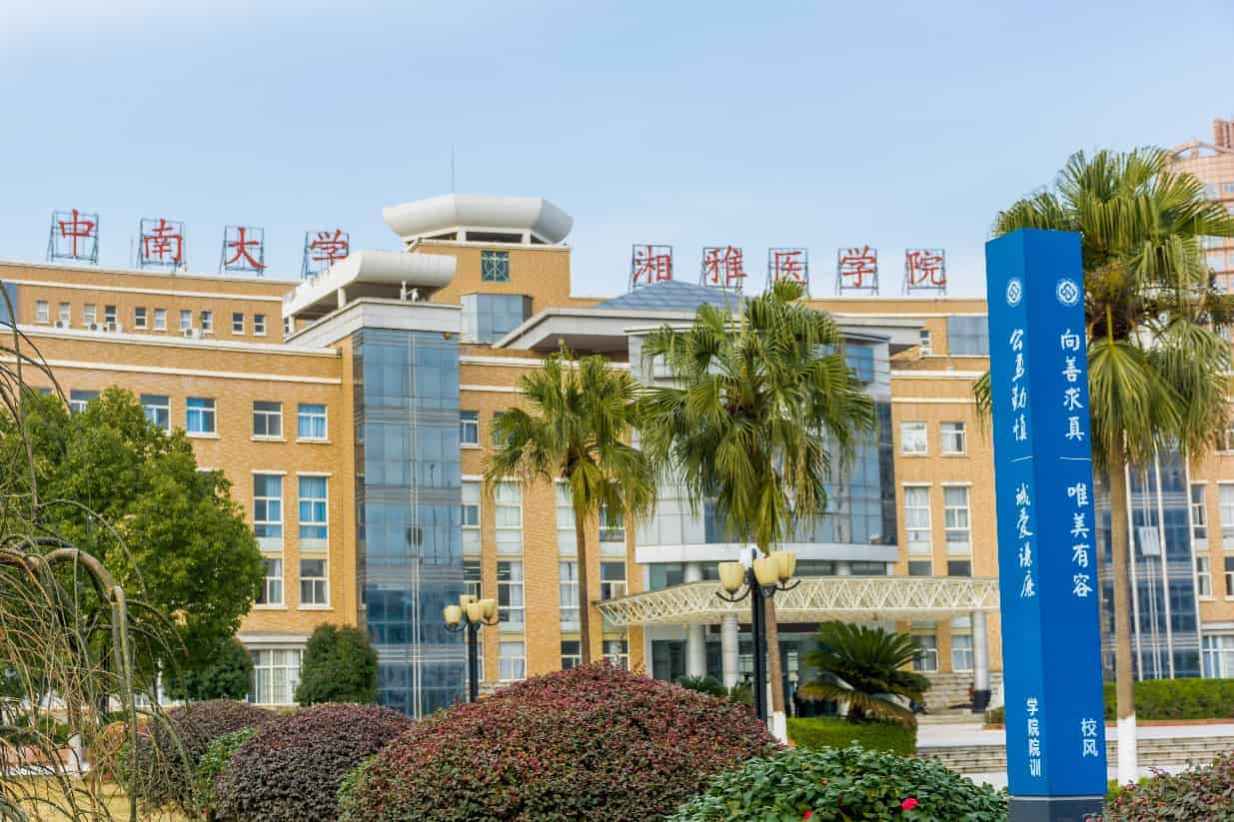
01、输入您的文字标题
添加标题
Click here to add your text.Click here to add your text，Click here to add your text.Click here to add your text，Click here to add your text.Click here
01
添加标题
Click here to add your text.Click here to add your text，Click here to add your text.Click here to add your text，Click here to add your text.
02
添加标题
Click here to add your text.Click here to add your text，Click here to add your text.Click here to add your text，Click here to add your text.Click here
03

Slide 20
01、输入您的文字标题
此处添加标题
此处添加标题
In the future, we need to work together to be creative, to be brave, to persist, to be persistent, to work hard, so as to create a beautiful future and happiness.
In the future, we need to work together to be creative, to be brave, to persist, to be persistent, to work hard, so as to create a beautiful future and happiness.
1
2
此处添加标题
3
4
此处添加标题
In the future, we need to work together to be creative, to be brave, to persist, to be persistent, to work hard, so as to create a beautiful future and happiness.
In the future, we need to work together to be creative, to be brave, to persist, to be persistent, to work hard, so as to create a beautiful future and happiness.

Slide 21
01、输入您的文字标题
10%
20%
30%
40%
此处添加标题
此处添加标题
此处添加标题
此处添加标题
In the future, we need to work together to be creative, to be brave, to persist, to be persistent, to work hard, so as to create a beautiful future and happiness.
In the future, we need to work together to be creative, to be brave, to persist, to be persistent, to work hard, so as to create a beautiful future and happiness.
In the future, we need to work together to be creative, to be brave, to persist, to be persistent, to work hard, so as to create a beautiful future and happiness.
In the future, we need to work together to be creative, to be brave, to persist, to be persistent, to work hard, so as to create a beautiful future and happiness.

Slide 22
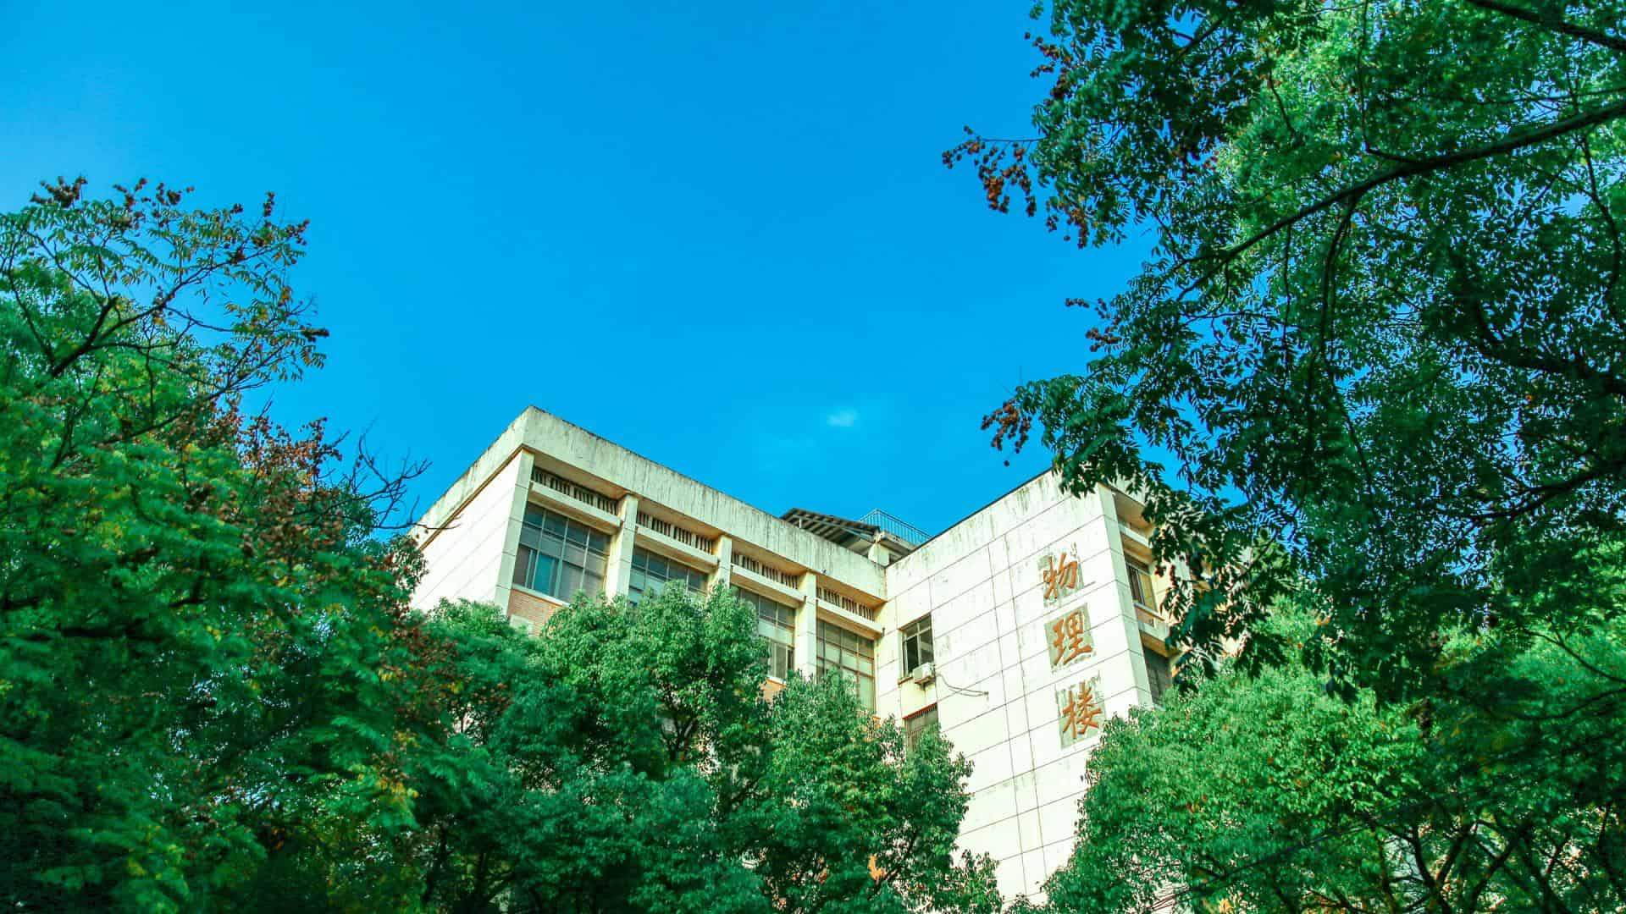
05
此处添加标题
In the future, we need to work together to be creative, to be brave, to persist, to be persistent, to work hard, so as to create a beautiful future and happiness.

Slide 23
此处添加标题
In the future, we need to work together to be creative, to be brave, to persist, to be persistent, to work hard, so as to create a beautiful future and happiness.
此处添加标题
46%.
In the future, we need to work together to be creative, to be brave, to persist, to be persistent, to work hard, so as to create a beautiful future and happiness.
此处添加标题
76%.
In the future, we need to work together to be creative, to be brave, to persist, to be persistent, to work hard, so as to create a beautiful future and happiness.
此处添加标题
89%
In the future, we need to work together to be creative, to be brave, to persist, to be persistent, to work hard, so as to create a beautiful future and happiness.

Slide 24
此处添加标题
In the future, we need to work together to be creative, to be brave, to persist, to be persistent, to work hard, so as to create a beautiful future and happiness.
关键字
关键字
关键字
In the future, we need to work together to be creative, to be brave, to persist, to be persistent, to work hard, so as to create a beautiful future and happiness.
In the future, we need to work together to be creative, to be brave, to persist, to be persistent, to work hard, so as to create a beautiful future and happiness.
In the future, we need to work together to be creative, to be brave, to persist, to be persistent, to work hard, so as to create a beautiful future and happiness.
In the future, we need to work together to be creative, to be brave, to persist, to be persistent, to work hard, so as to create a beautiful future and happiness.

Slide 25
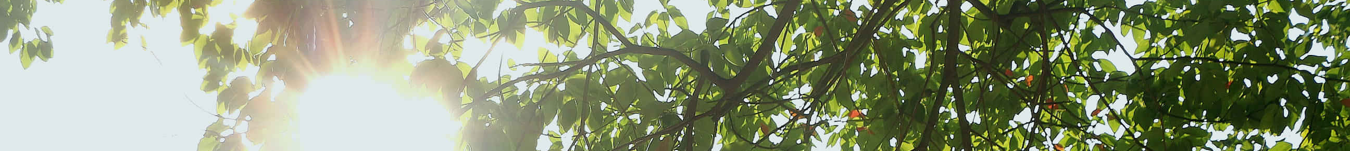
此处添加标题
In the future, we need to work together to be creative, to be brave, to persist, to be persistent, to work hard, so as to create a beautiful future and happiness.
关键字
关键字
关键字
In the future, we need to work together to be creative, to be brave, to persist, to be persistent, to work hard, so as to create a beautiful future and happiness.
In the future, we need to work together to be creative, to be brave, to persist, to be persistent, to work hard, so as to create a beautiful future and happiness.
In the future, we need to work together to be creative, to be brave, to persist, to be persistent, to work hard, so as to create a beautiful future and happiness.
In the future, we need to work together to be creative, to be brave, to persist, to be persistent, to work hard, so as to create a beautiful future and happiness.

Slide 26
谢谢观看
Recalling good times in the past
In the future, we need to work together to be creative, to be brave, to persist, to be persistent, to work hard, so as to create a beautiful future and happiness.

Slide 27
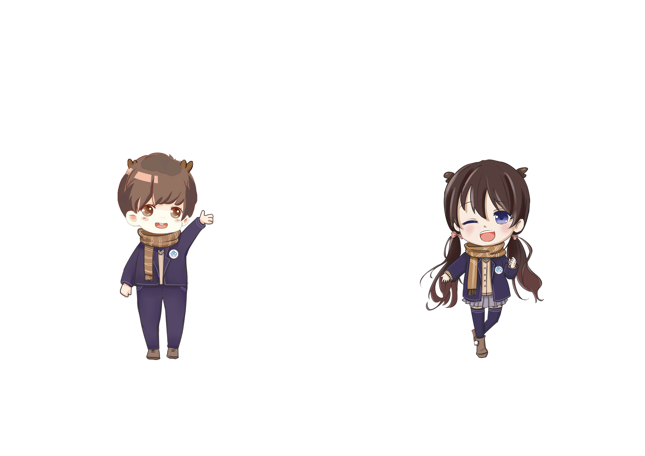

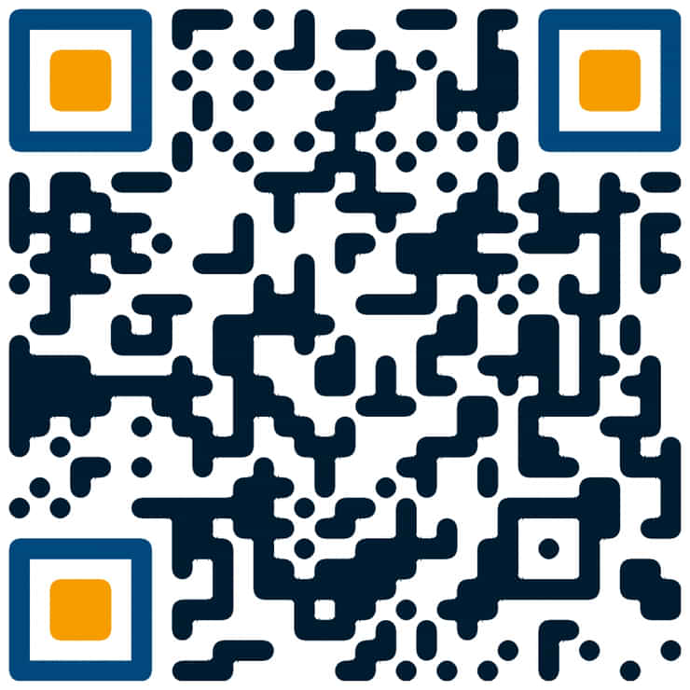
“中南云麓谷”新媒体中心 出品
中南大学学生工作部（处）官方微信
关注微信公众号“中南云麓谷”
定期共享优质资源

